Slide 1
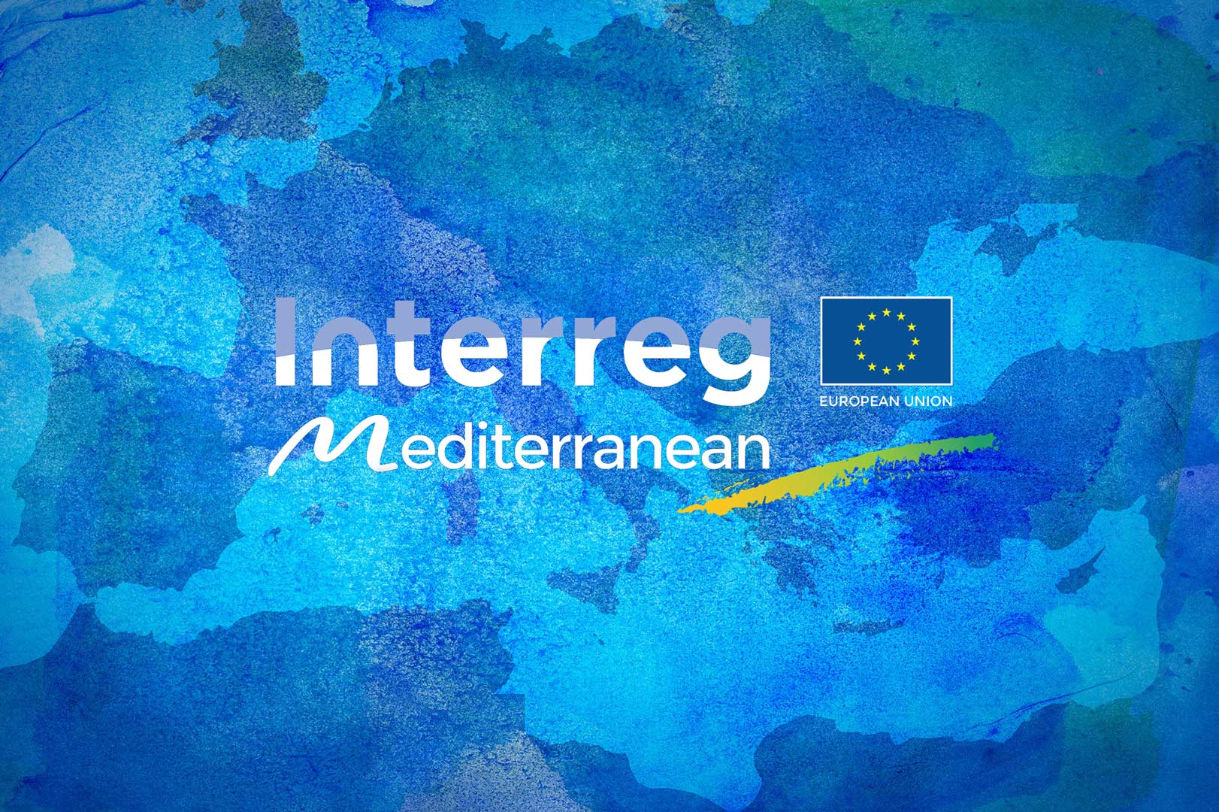
Interreg MED project communications
Laura Pugieu – Communications officer

Slide 2
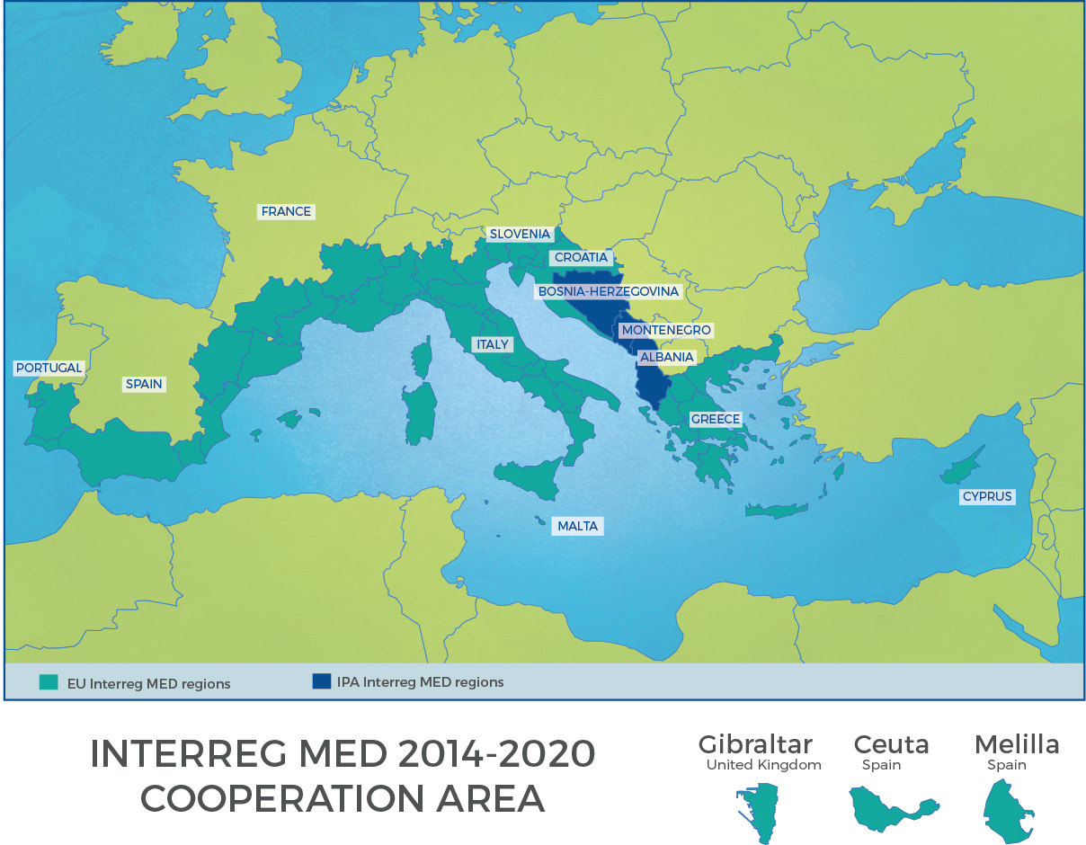
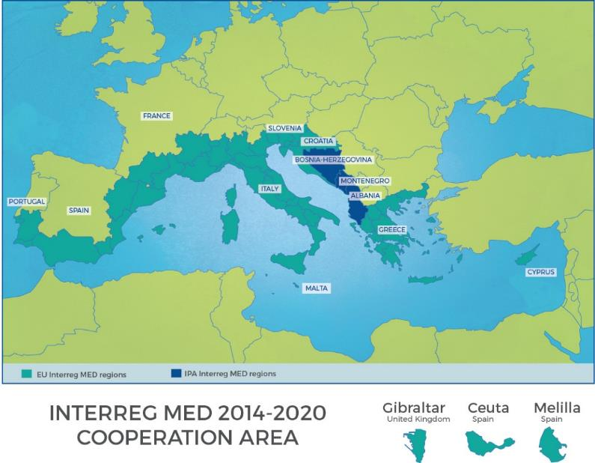
13 countries 57 regions in MED
10 EU MS + 3 IPA countries
122 million inhabitants
860 000 km²  15 000 km coastal area
  ERDF funds: ≈224 M€
  IPA funds: ≈ 9 M€
  TOTAL including national co-funding: 265 M€
  91 projects

Slide 3




Three thematic priority axes
One territorial priority axis
PRIORITY AXIS 1
Promoting Mediterranean innovation capacities to develop smart and sustainable growth
PRIORITY AXIS 2
Fostering low carbon strategies and E.E. in specific MED territories: cities, islands and remote areas
PRIORITY AXIS 3
Protecting and promoting Mediterranean natural and cultural resources
Areas
PRIORITY AXIS 4
A shared Mediterranean Sea
71,7 M€ ERDF
2,9 M€ IPA
44,8 M€ ERDF
1,8 M€ IPA
76,2 M€ ERDF
3,2 M€ IPA
17,9 M€ ERDF
0,7 M€ IPA

Slide 4
Communication rules
Use of harmonized Interreg logo
Poster templates provided by the JS
Restrictions on goodies
Project website provided by the JS with intranet and discussion groups, deliverable library and a tool to share news & events directly on each project website
Minimum compulsory communication activities depending on the type of projects

Slide 5






The Programme architecture
Different types of projects depending on which type of activities they are carrying on:
The modules
  Module 1: STUDYING: designing common approaches & strategies at TN
  Module 2: TESTING: Pilot demonstration actions
  Module 3: CAPITALISING: Transfer, dissemination and capitalisation
The modular projects
The horizontal projects:
                community building
                joint communication
                joint capitalisation/transfer
Single
Module
Combination
of Modules
Focus on synergies mechanisms, thematic communities
Notes:
Horizontal projects: They are in charge of community building activities, joint communication and capitalisation of their projects. They shall allow real synergies and provide a better visibility to reach policy making level.

Slide 6
How we support PP and what we do
Helpdesk
Video tutorials (Typo3)
Guides (Synergie, Typo3)
Templates for event registration form & end user beneficiaries
Webinars and trainings (last training on lobbying and story telling)
Team building activities, brainstormings and consultations
What have we been willing to achieve?
Build a strong Interreg MED community

Slide 7
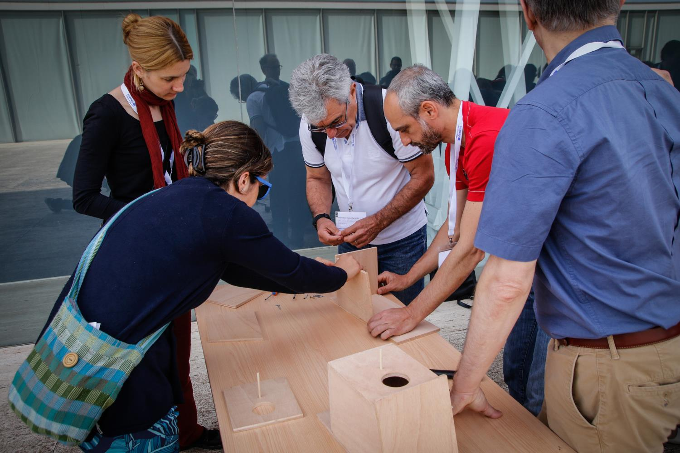
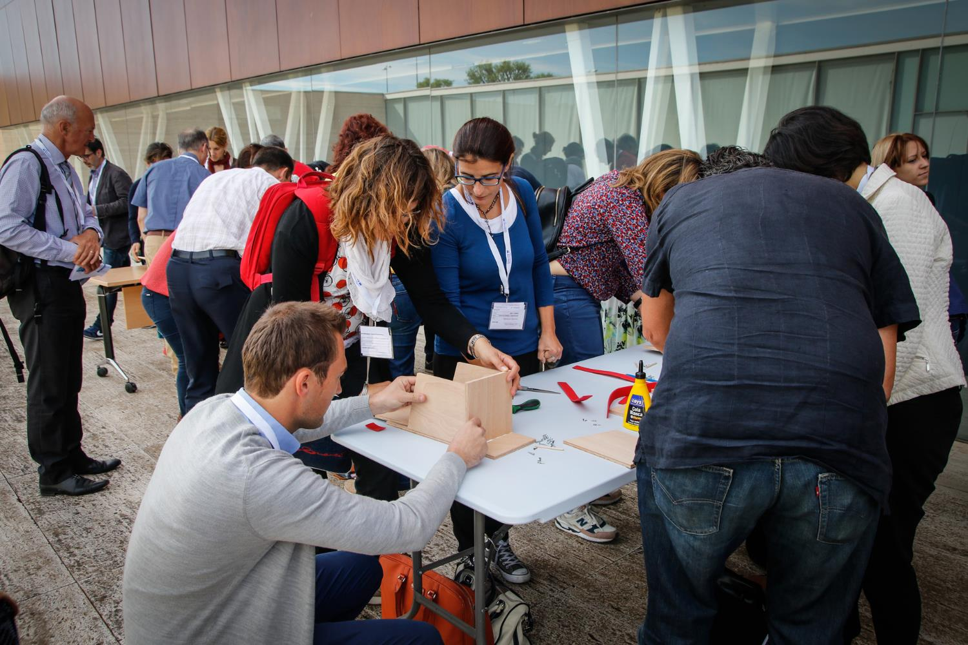
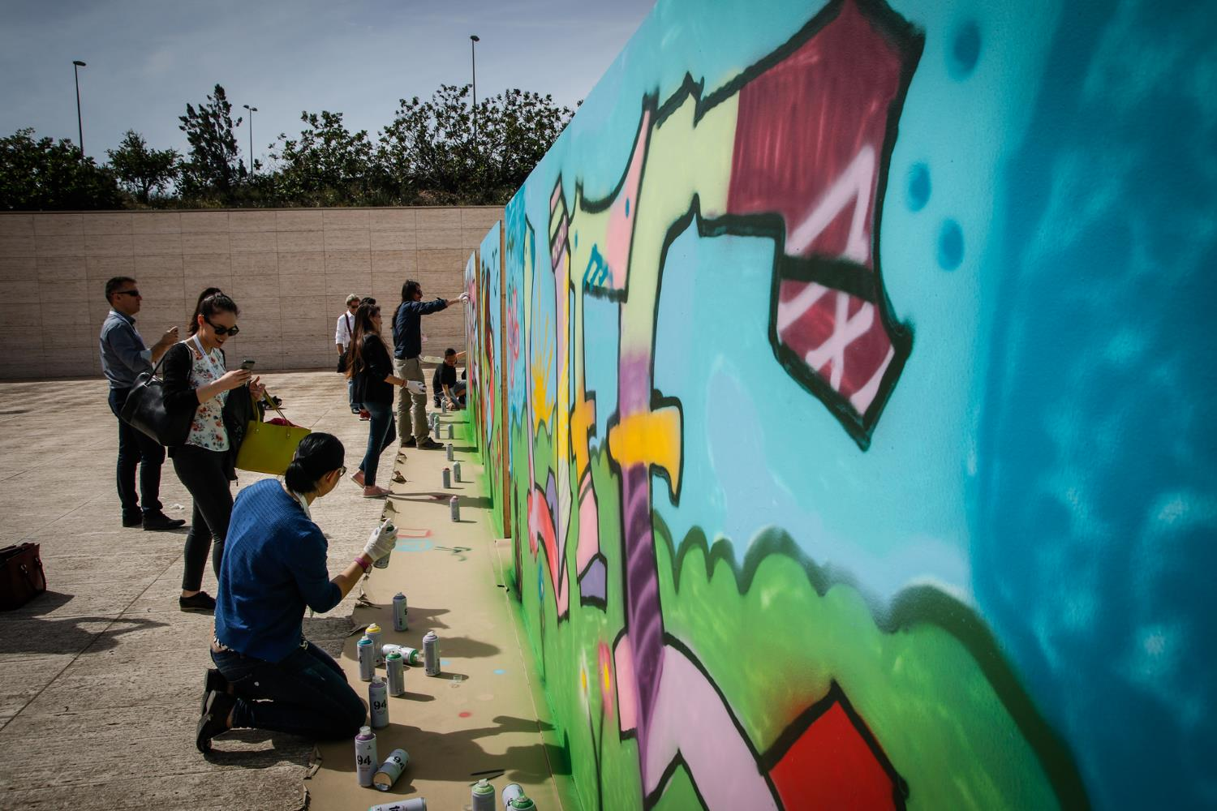
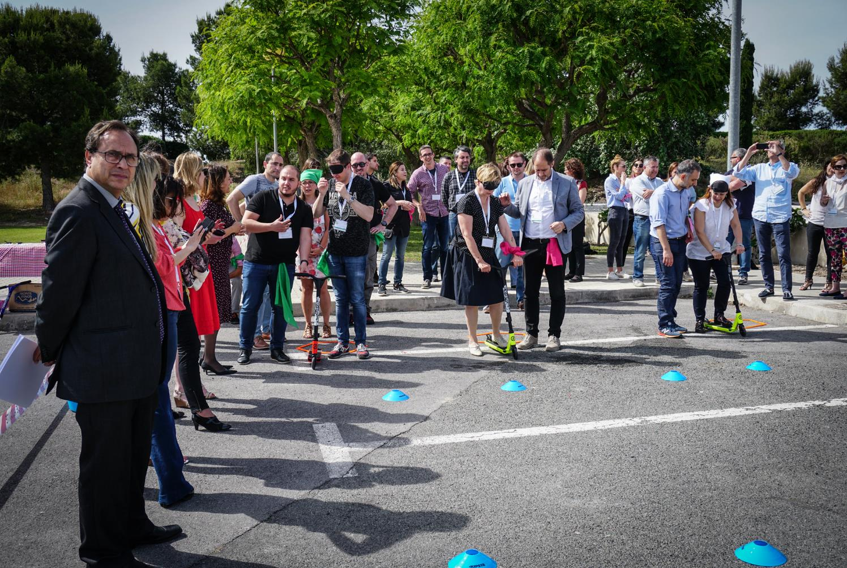
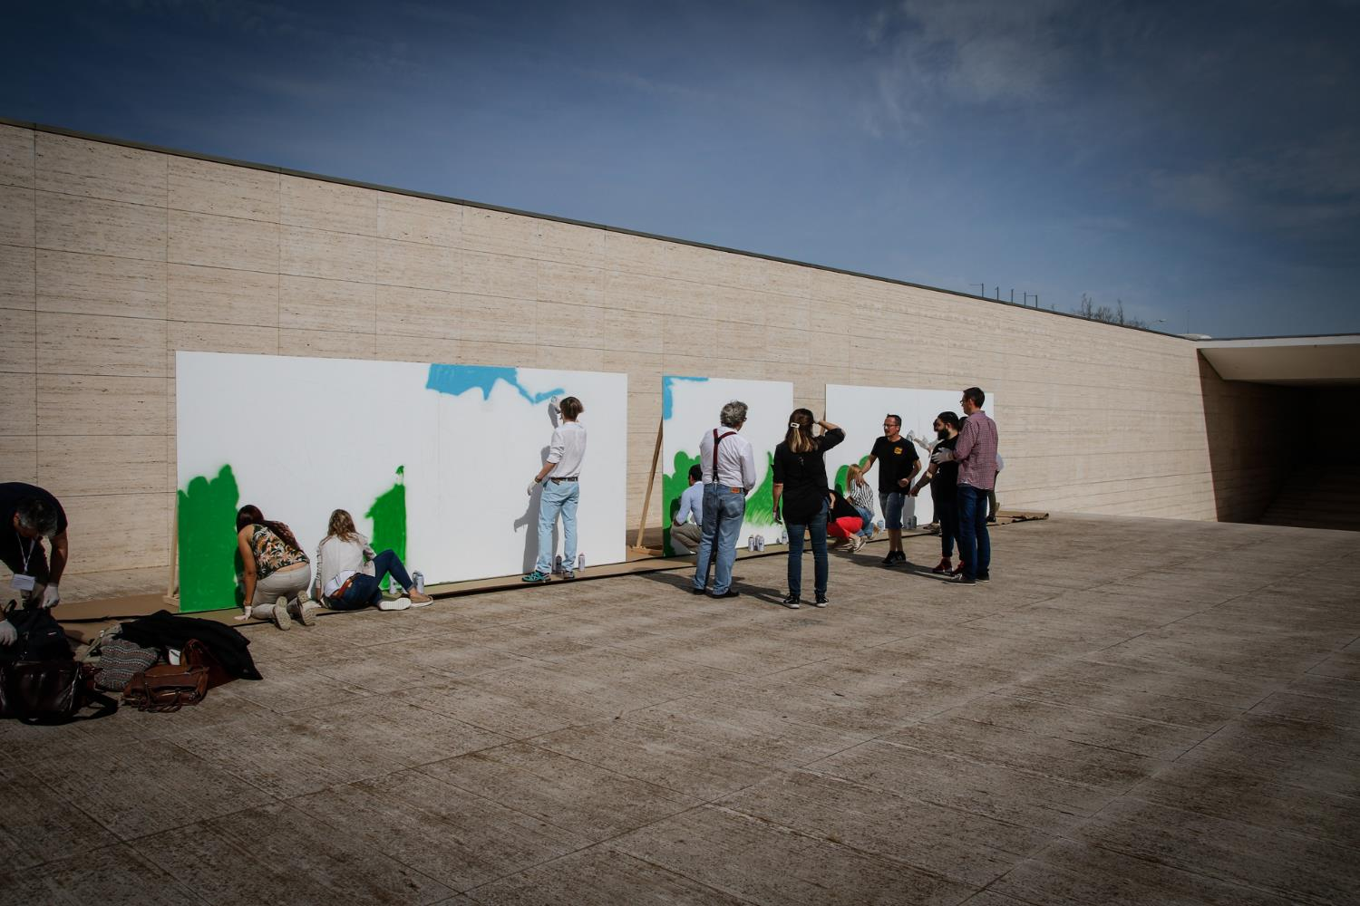
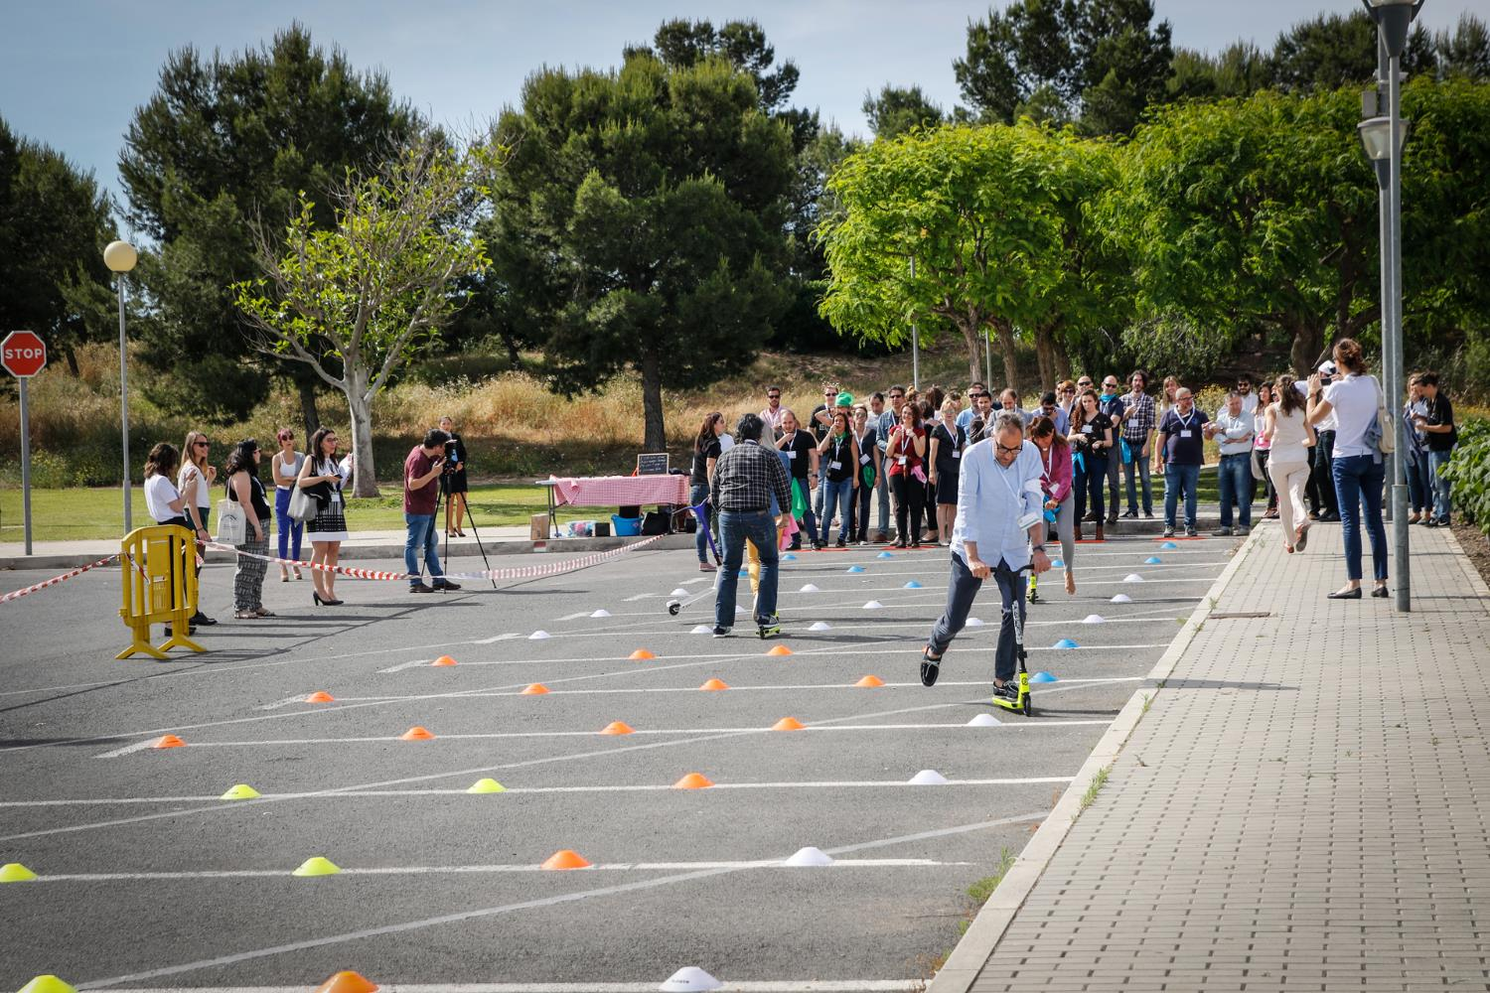

Slide 8
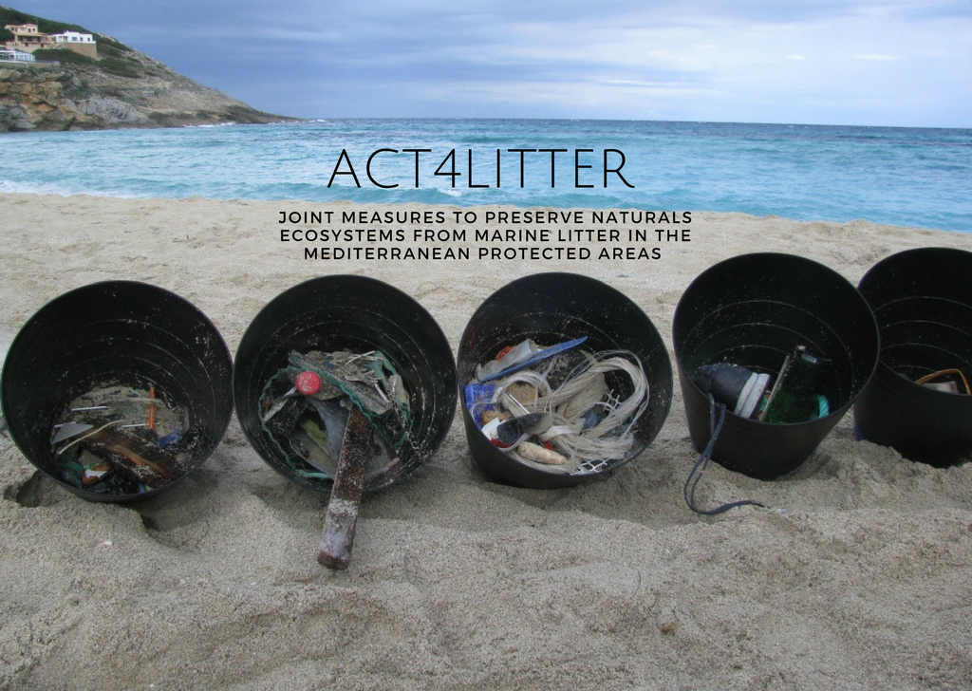
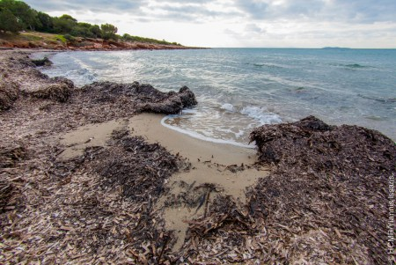
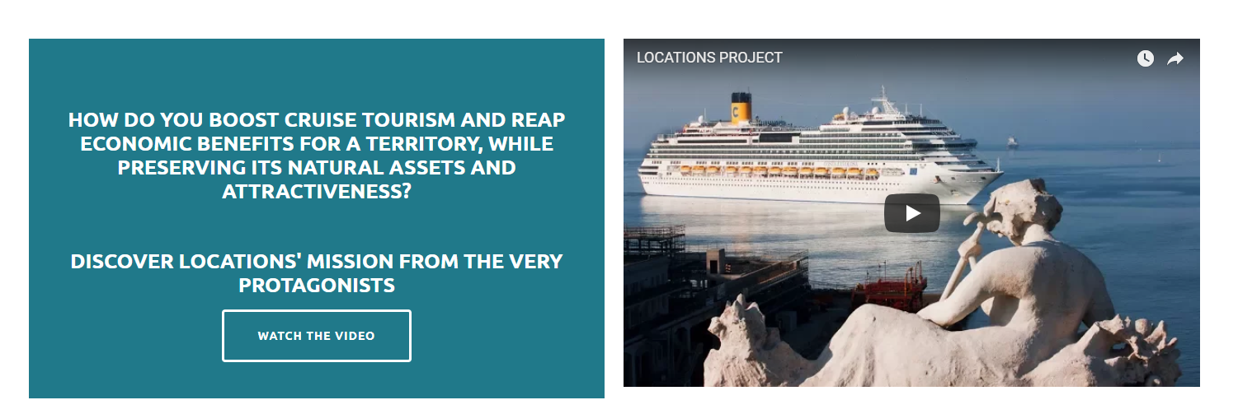
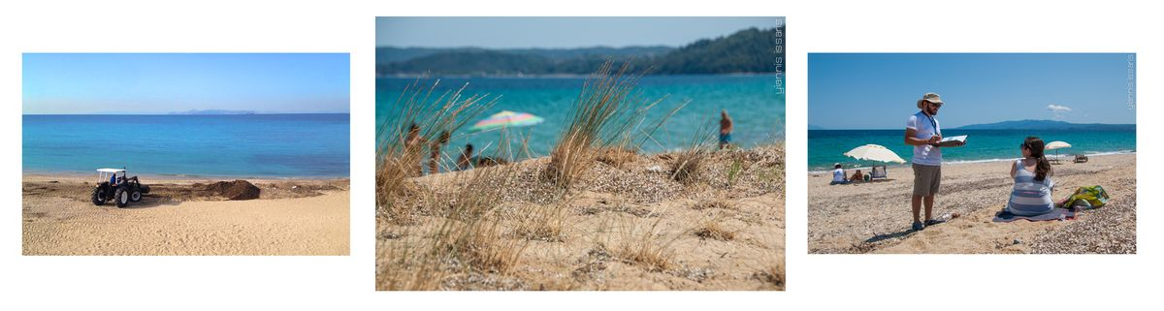
Good practices
FISHERMEN AND MARINE PROTECTED AREAS, A PARTNERSHIP FOR SUSTAINABILITY IN THE MEDITERRANEAN
Mediterranean Marine Protected Areas (MPAs) have proliferated in recent years, with positive long-term results for local communities and in particular artisanal fisheries. In the short term, however, the creation of MPAs is often subject to strong opposition from local fishermen: MPAs can be perceived as limiting their activities and therefore incomes. The FishMPABlue2 project addresses existing and potential conflicts and proposes solutions. FishMPABlue2 involves key actors in the planning of conservation measures and fishery regulation processes within blue-economy-driven sustainable governance.
Costumize poster templates and project websites: Locations & BlueIslands and GRASPINNO
Short, simple and concise sentences and use of tailored vocabulary
Simple vocabulary, no jargon
Good and increased use of visual communications:
Videos: fun and short
Photos: personalised pictures that tell a story, not from image bank
Good use of social media
High participation and engagement on Facebook and Twitter
Appropriate hastags
Tag the Programme on publications
Online trainings and webinars instead of organising on site events
Team building events among thematic communities
High involvement in thematic community events & HPs commitment
=> Synergies between projects, organise events (Greening initiative and webinar, Ecomondo, etc.) and activities together
Withering leaves and rhizomes of seagrasses cushioning sandy beaches often represent an aesthetic problem for mainstream tourism in the Mediterranean. Tons of this material are removed and disposed in many coastal areas in an effort to maintain them attractive. However, removal may affect beach erosion and the growth of adjacent dune vegetation.
POSBEMED aims to enhance awareness on the benefits of this natural capital. This project will offer common sustainable tools to improve management capacity, with practical and effective guidelines for beach users and managers. Its final goal is to develop a transnational joint management strategy for Posidonia meadows, beaches and foredune systems along the Mediterranean coasts.
In the summer season, mediterranean islands host a far greater population. This is beneficial for the local economies, but it also places a great burden on the local infrastructures, especially for waste management systems. By improving knowledge about waste streams, building common guidelines and improving synergies among MED islands’ communities, BLUEISLANDS project aims to promote sustainable tourism patterns and fuel local loops of circular economy.

Slide 9
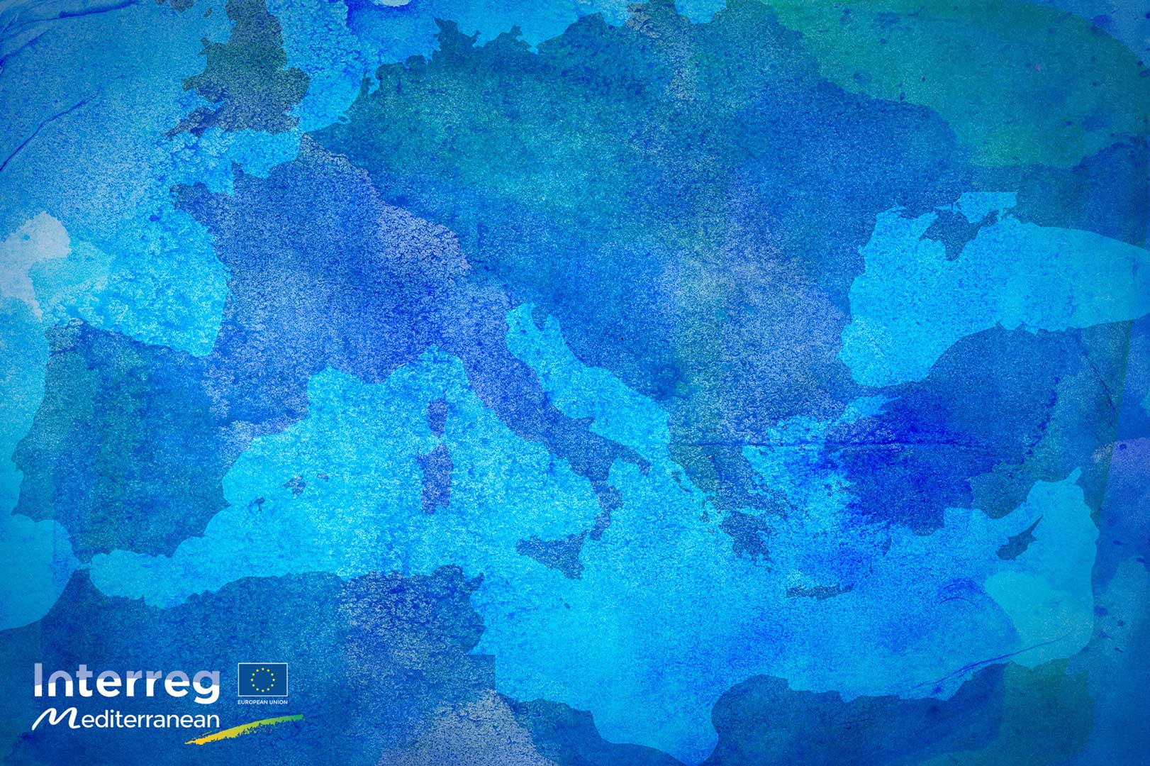
THANK YOU

