Slide 1


Slide 2
Programme Budget
EUR 213,105,953.00 EU contribution
„INTERREG funds” – bringing together ERDF, IPA and NDICI funds
Maximum EU contribution is 80%
Allocated budget (EU contribution) for Specific Objective 4.2: EUR 25.651.401,75

Slide 3
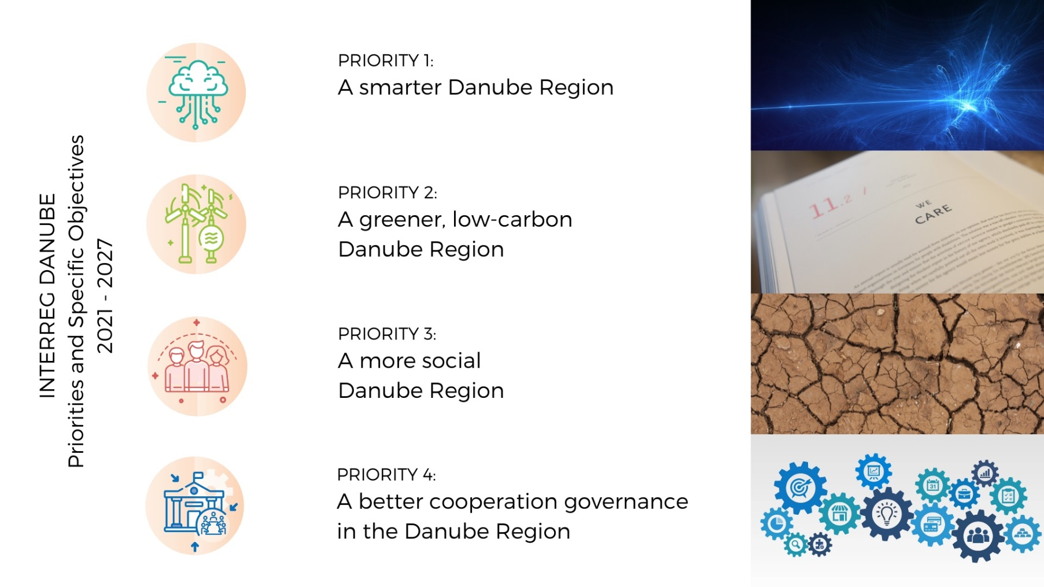
Programme Priorities

Slide 4
Priority 4 Governance
Priority 4: A better cooperation governance in the Danube Region
S.O.: 4.1. Enhance institutional capacity of public authorities and stakeholders to implement macro-regional strategies and sea-basin strategies, as well as other territorial strategies
Support to the EUSDR governance
  Direct support for Priority Areas Coordinators / PAC
  Danube Strategy Point / DSP
  Seed Money / Small Project funding facility
RESTRICTED CfPs only!
S.O.: 4.2 Increased institutional capacities for territorial and macro-regional governance
“Standard” projects

Slide 5
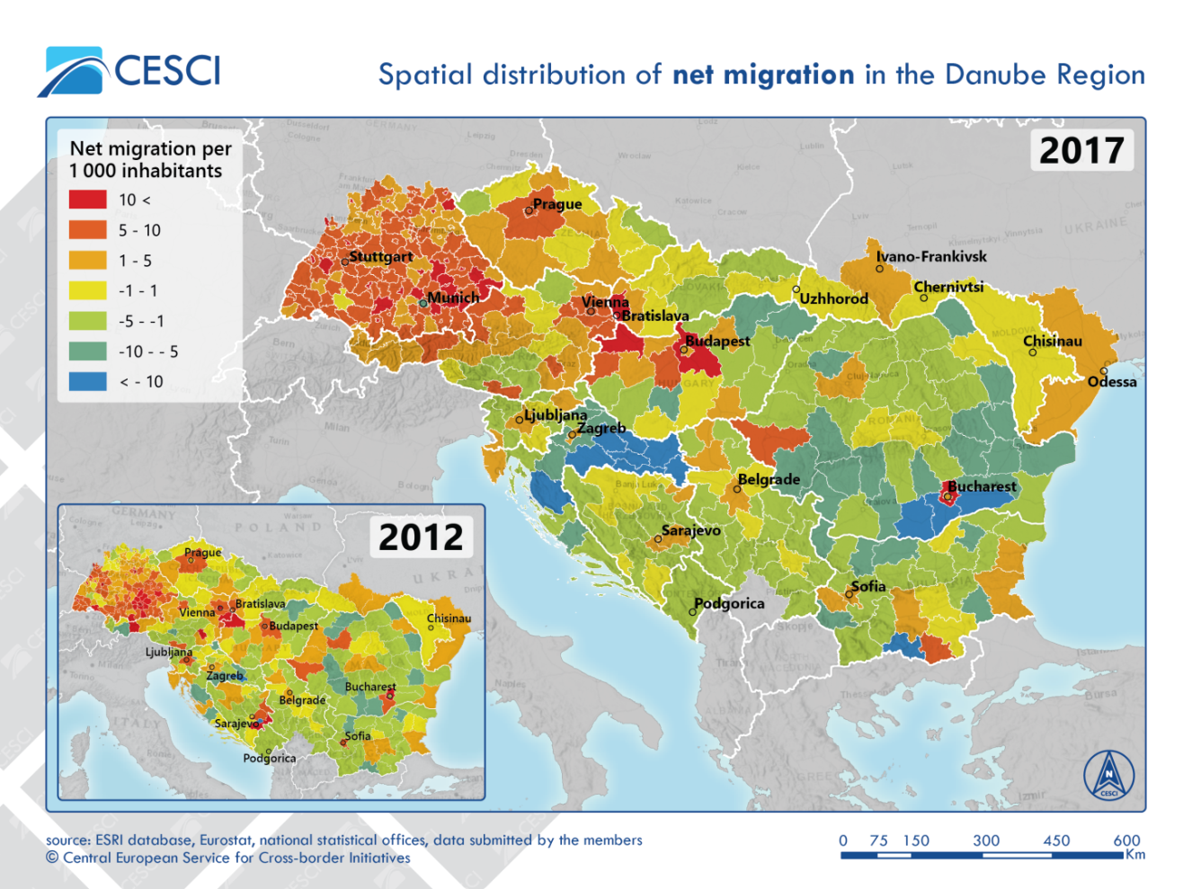
Challenges
Specific Objective 4.2
Huge discrepancies in territorial development (-policies) across the DR
Institutional integration / cooperation across borders lagging behind
Urban-rural divide – lack of polycentric development
Insufficient local and civil participation in territorial development processes
Missing (institutional) capacities for developing, applying, adapting and implementing integrated territorial development policies
…

Slide 6
Focus
Specific Objective 4.2
Integrated governance models for addressing challenges arising from demographic change (e.g. aging, depopulation, brain drain)
Integrated urban-rural governance models including specific territorial development strategies for rural/remote areas
Support for more and stronger inter-institutional relations for the integrated development of transboundary functional areas
Capacity building considering especially a better involvement of local and regional public bodies as well as civic actors in transnational policy making, territorial development frameworks and governance models
Support for the monitoring and analysis of territorial processes affecting the cohesion and cooperation of the Danube Region

Slide 7
Focus
Specific Objective 4.2
The improved provision of public services of general interest and digitalization to be considered as horizontal elements
All measures shall substantially take into account existing main territorial/spatial development frameworks such as the Territorial agenda 2030 or the New Leipzig Charter
Integrated / holistic approaches expected - not only by integration of different administrative levels but also through embedding sectorial aspects like transport or accessibility into broader territorial governance scenarios

Slide 8
Partnership
Specific Objective 4.2
Critical mix of PPs, reflecting the integrated / holistic character of S.O. 4.2
Strong local and civic ownership expected
Exact composition and size depending on individual topic(s) but sufficient “weight” for leaving a footprint on transnational level is indispensable

Slide 9
What do we NOT finance under S.O. 4.2
Specific Objective 4.2
Projects which do not demonstrate that cooperation is needed on transnational level to address the identified governance-challenges
Projects not being clearly embedded in a territorial scenario and not considering respective existing frameworks
Projects with pre-dominant focus on infrastructure or mere technical (IT-) solutions;
Projects lacking multi-level governance character with respect to objectives, activities, outputs and especially partnership composition
Projects with narrowed sectorial focus (e.g. project focussing on educational/training schemes for certain target groups might fit better under Priority 3)

Slide 10

Background frameworks
Specific Objective 4.2
Territorial Agenda 2030
The Territorial Agenda underlines the importance of and provides orientation for strategic spatial planning and calls for strengthening the territorial dimension of sector policies at all governance levels. It seeks to promote an inclusive and sustainable future for all places and to help achieve Sustainable Development Goals in Europe.
Two overarching objectives, a Just Europe and a Green Europe, which have six priorities for developing the European territory as a whole, along with all its place
New Leipzig Charta
Unlashing the transformative power of cities through integrated urban development, with a place-based, multi-level and participatory approach:
The just city
The green city
Digitalization

Slide 11
2nd Call for Proposal
Specific Objective 4.2
1-step procedure
Info Webinars ongoing
National Info Days ongoing
Launch in the upcoming weeks (full info-package available then)
Submission: 29th February 2024
Final approval not before end of 2024

Slide 12
Contact
Specific Objective 4.2
Danube Programme Website:
www.interreg-danube.eu
Senior Project Officer Priority 4 / Governance + EUSDR:
Johannes Gabriel
johannes.gabriel@interreg-danube.eu

